Slide 1
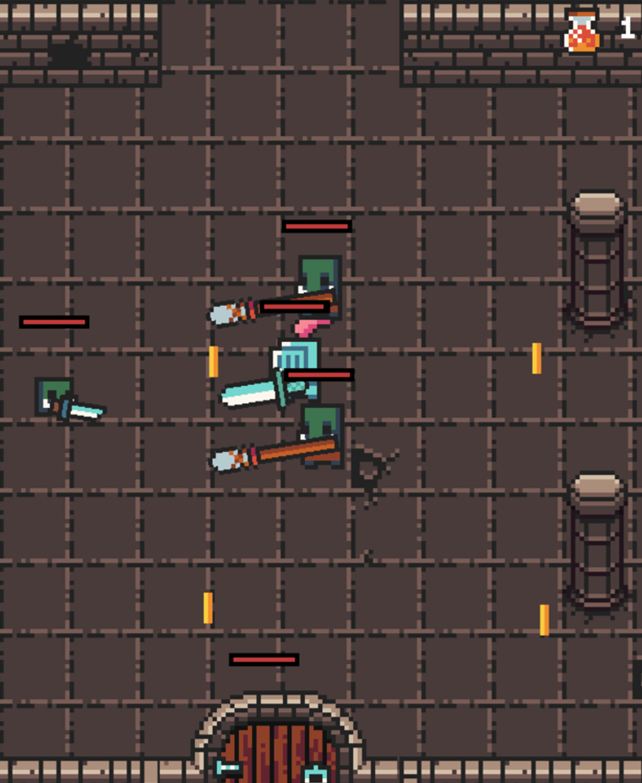
Dungeons and Knights
Luca Ritz & Lukas Seglias

Slide 2
Idee
Pixelart + Dungeon Crawler + Fantasy setting

Slide 3


Slide 4
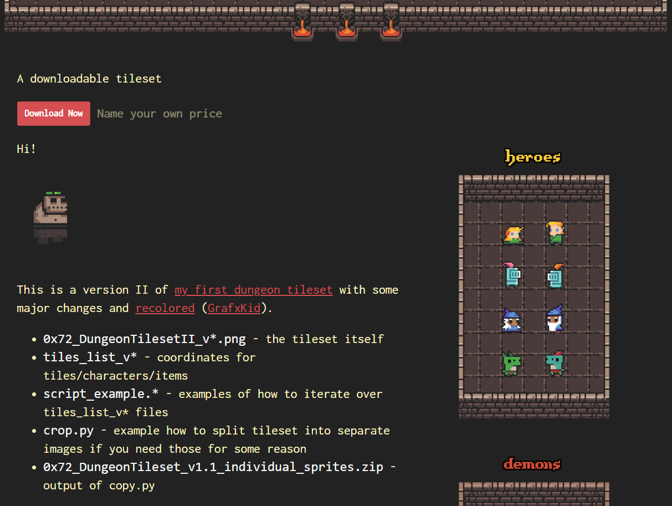
0x72_DungeonTilesetII_v1.3.1

Slide 5
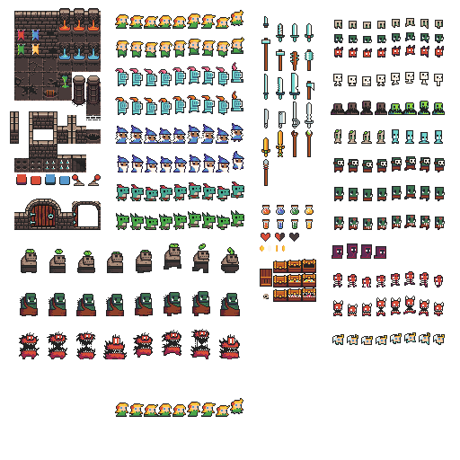

Slide 6
Tilemap

Slide 7
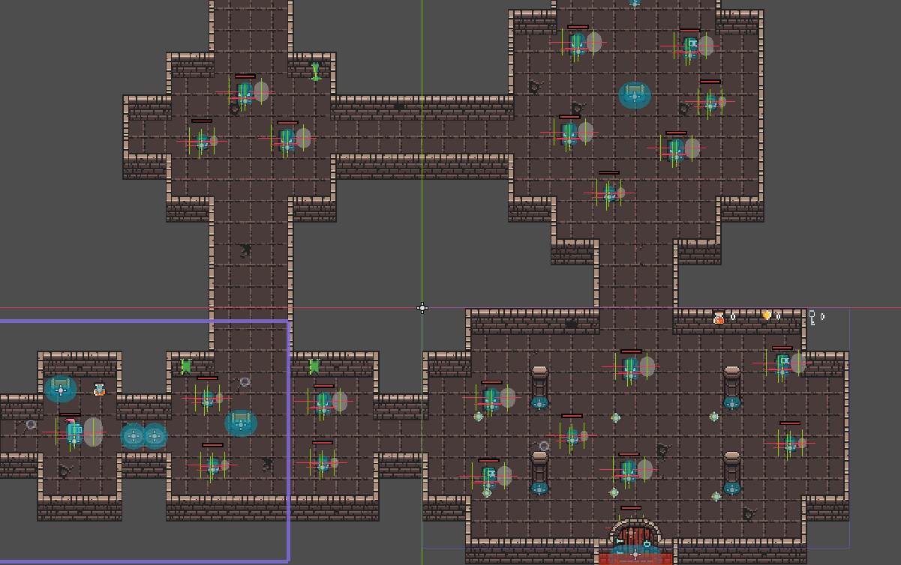

Slide 8
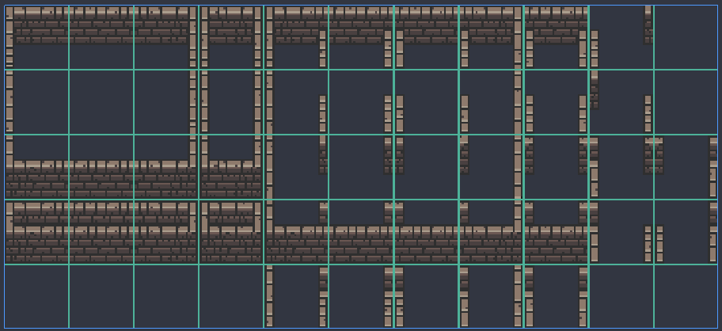

Slide 9
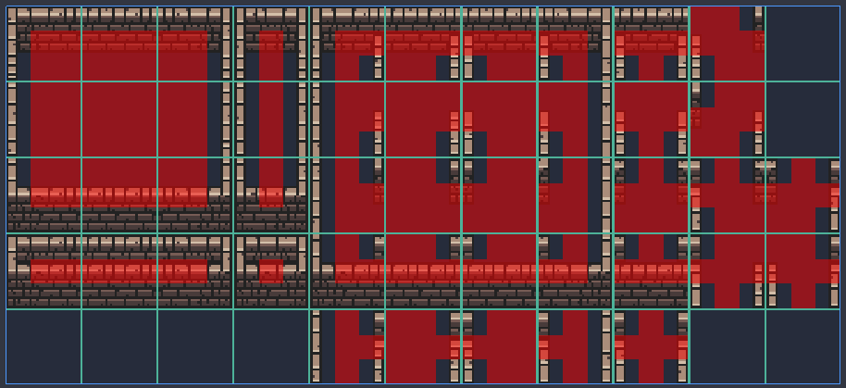
Bitmaske

Slide 10
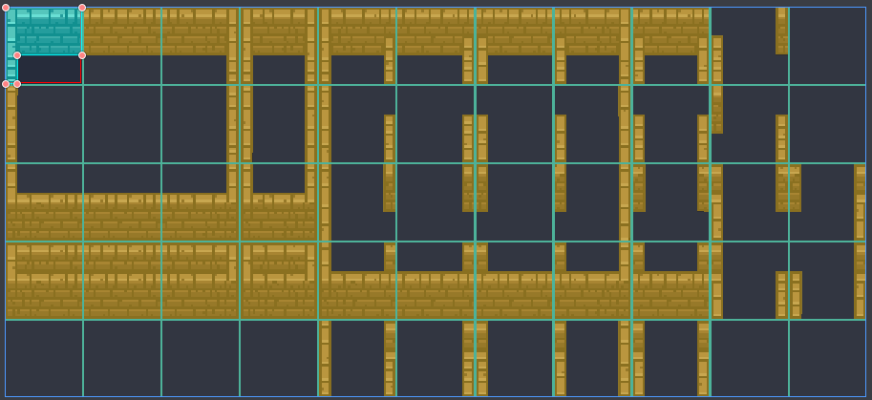
Kollision

Slide 11
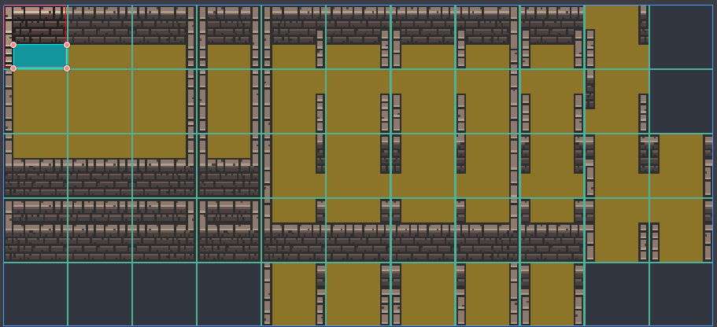
Navigation

Slide 12
Kampfsystem

Slide 13
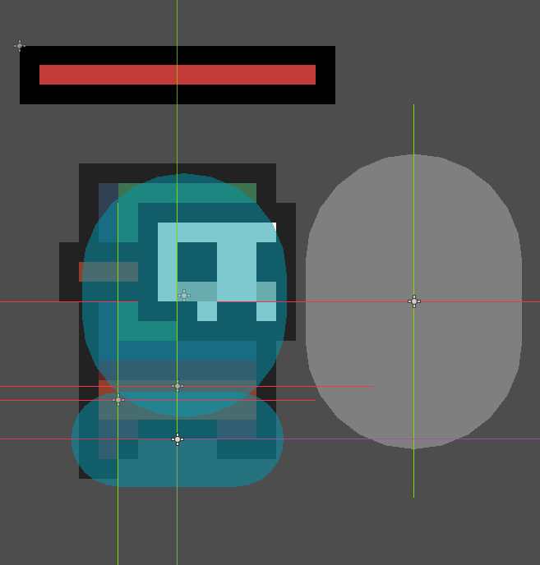
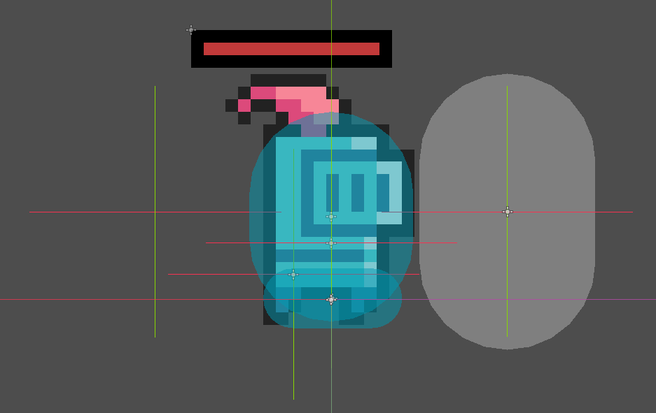
Hurtbox
Hitbox

Slide 14
Demo

